Slide 1
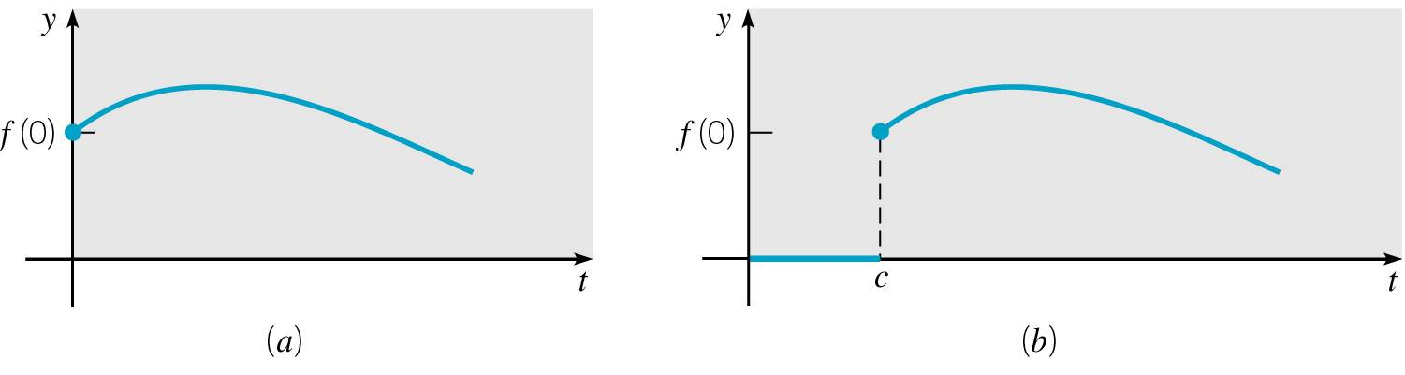
Ch 6.3: Step Functions
Some of the most interesting elementary applications of the Laplace Transform method occur in the solution of linear equations with discontinuous or impulsive forcing functions.
In this section, we will assume that all functions considered are piecewise continuous and of exponential order, so that their Laplace Transforms all exist, for s large enough.

Slide 2
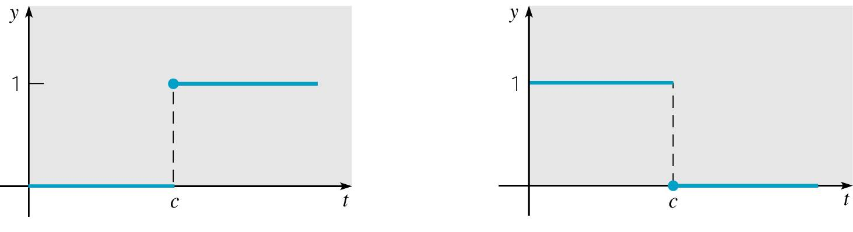
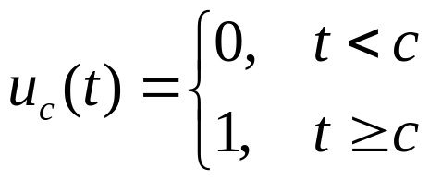
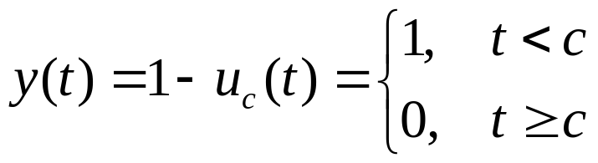
Step Function definition
Let c ≥ 0. The unit step function, or Heaviside function, is defined by
A negative step can be represented by

Slide 3

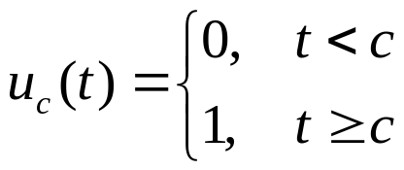
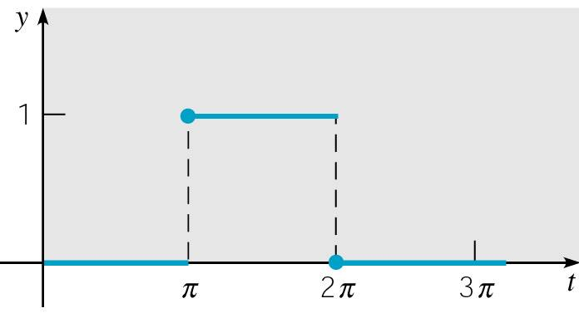
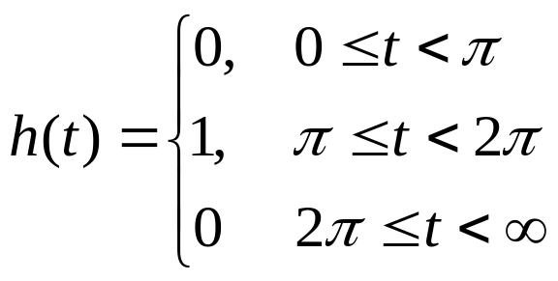
Example 1
Sketch the graph of
Solution: Recall that u_{c}(t) is defined by
Thus
and hence the graph of h(t) is a rectangular pulse.

Slide 4
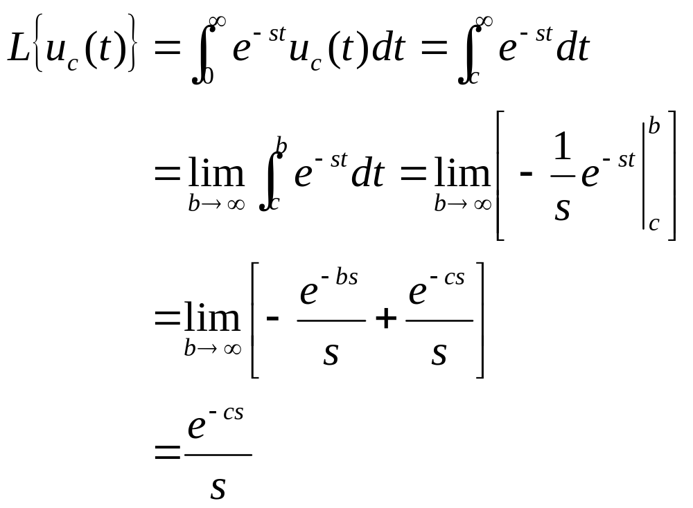
Laplace Transform of Step Function
The Laplace Transform of u_{c}(t) is

Slide 5
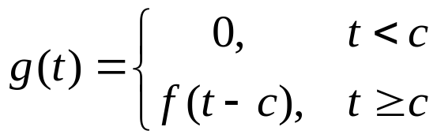
Translated Functions
Given a function f (t) defined for t ≥ 0, we will often want to consider the related function g(t) = u_{c}(t) f (t - c):
Thus g represents a translation of f a distance c in the positive t direction.
In the figure below, the graph of f is given on the left, and the graph of g on the right.

Slide 6
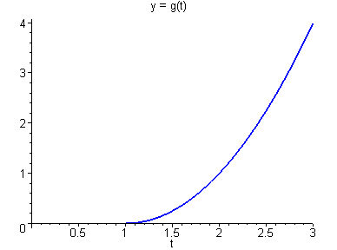
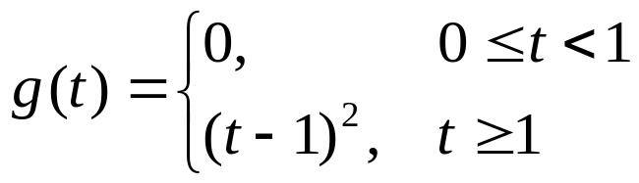
Example 2
Sketch the graph of
Solution: Recall that u_{c}(t) is defined by
Thus
and hence the graph of g(t) is a shifted parabola.

Slide 7

Theorem 6.3.1
If F(s) = L{f (t)} exists for s > a ≥ 0, and if c > 0, then
Conversely, if f (t) = L⁻¹{F(s)}, then
Thus the translation of f (t) a distance c in the positive t direction corresponds to a multiplication of F(s) by e^{-cs}.

Slide 8
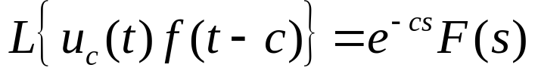
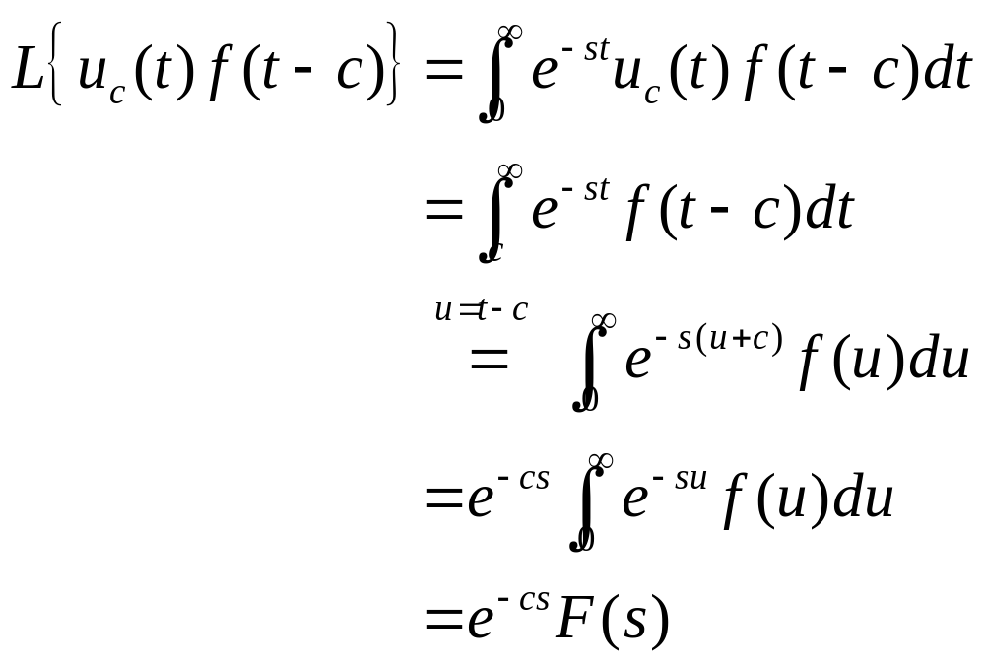
Theorem 6.3.1: Proof Outline
We need to show
Using the definition of the Laplace Transform, we have

Slide 9

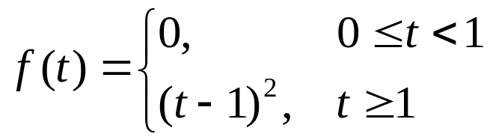

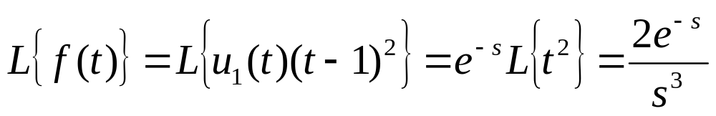
Example 3
Find the Laplace transform of
Solution: Note that
Thus

Slide 10
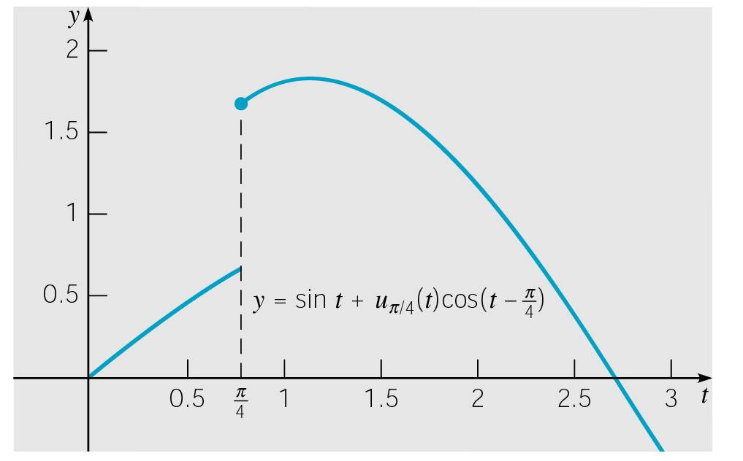
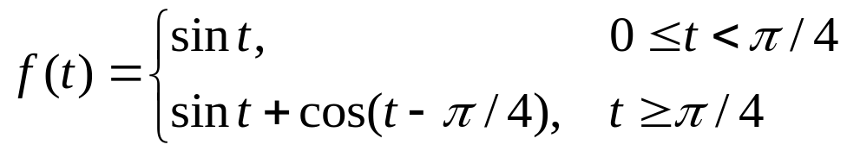
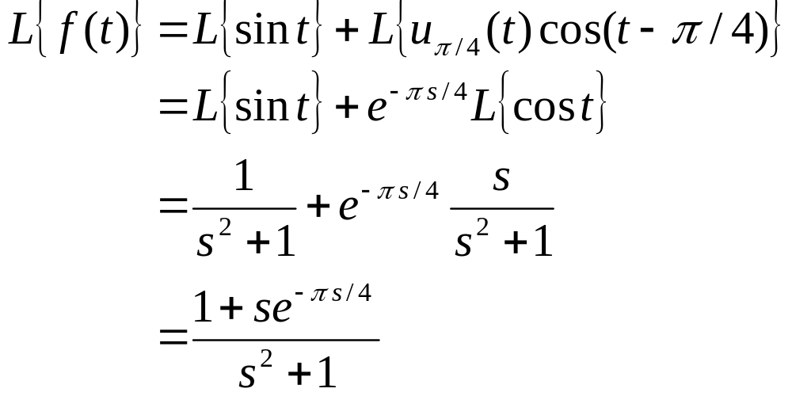
Example 4
Find L{ f (t)}, where f is defined by
Note that f (t) = sin(t) + u_{π/4}(t) cos(t - π/4), and

Slide 11
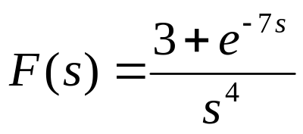
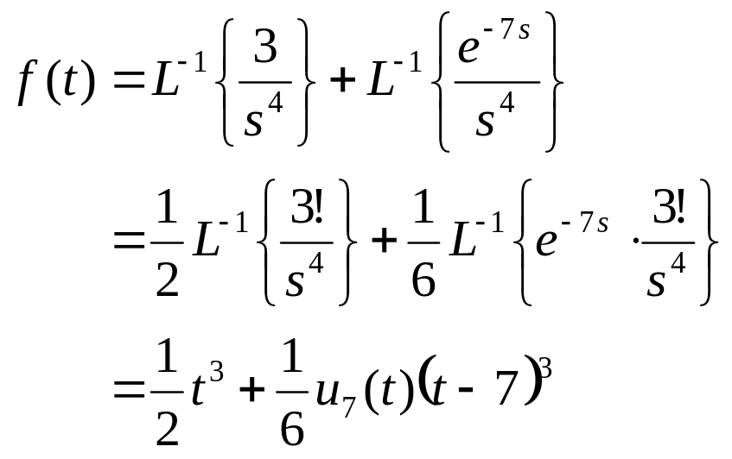
Example 5
Find L⁻¹{F(s)}, where
Solution:

Slide 12


Theorem 6.3.2
If F(s) = L{f (t)} exists for s > a ≥ 0, and if c is a constant, then
Conversely, if f (t) = L⁻¹{F(s)}, then
Thus multiplication f (t) by e^{ct} results in translating F(s) a distance c in the positive t direction, and conversely.
Proof Outline:

Slide 13
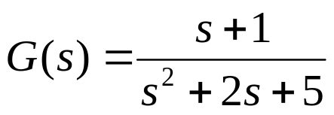
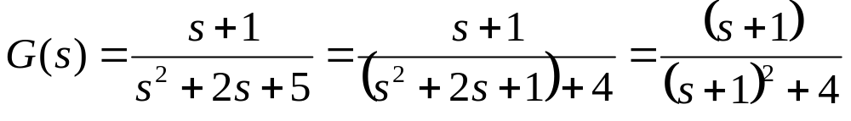
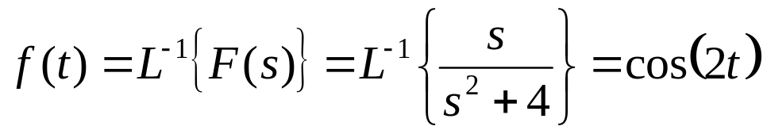
Example 4
Find the inverse transform of
To solve, we first complete the square:
Since
it follows that

